Slide 1

Search 4

Slide 2
Previously...
Path-based search
Uninformed search
Informed search
Depth-first, breadth first, uniform-cost search
Best-first, A* search
Iterative-improvement search
Hill climbing: greedy method
Meta-heuristic algorithms

Slide 3
Adversarial search
Competitive environments: Game
the agents’ goals are in conflict
We consider:
* two players, turn-taking
* zero-sum games
Type of games:
* deterministic v.s. stochastic
* perfect v.s. partially observable information
Most common games are deterministic, turn-taking, two-player, zero-sum games with perfect information.

Slide 4
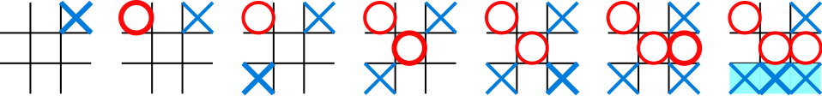
Example
两人轮流在一有九格方盘上划加字或圆圈, 谁先把三个同一记号排成横线、直线、斜线, 即是胜者

Slide 5
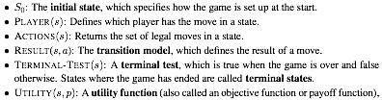
Definition of a game
two players: MAX and MIN

Slide 6
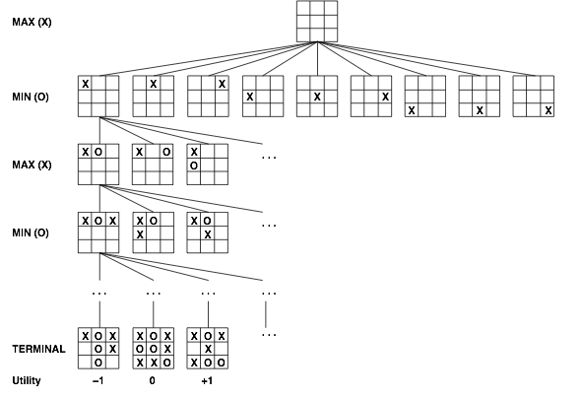
Tic-tac-toe search tree

Slide 7
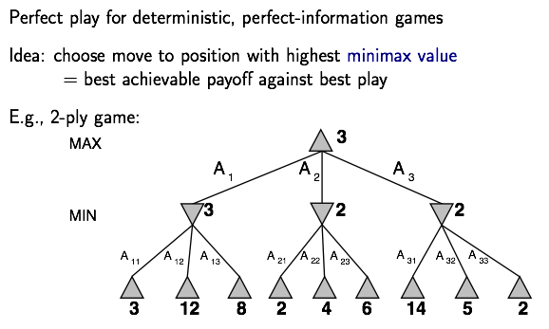

Optimal decision in games
假设对方是一个最强悍的对手，在此假设下，获得可能的最大的utility

Slide 8
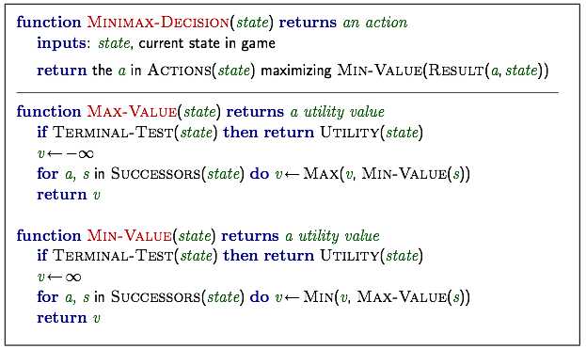
(针对用户max，返回当前最优的动作)
Minimax algorithm

Slide 9
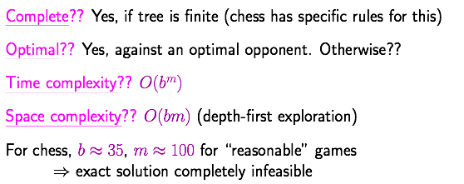
Properties of Minimax

Slide 10
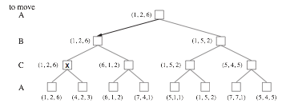
Multiple players
a vector is used for 3 players
多个player，可能并不是zero-sum游戏；
每个state存储一个utility的向量，记录对于每个player的utility；
考虑对于某个play有多个最优选择的情况
Notes:
在多人的情况下，对自己最佳，并不意味着对其余所有人最差

Slide 11
Multiple players
最顶层节点的vector写的不合理，不应该因为两
个儿子的vector在第一个分量的值相同而随便取某个儿子
的vector作为结果。
2017 姚宇浩

Slide 12
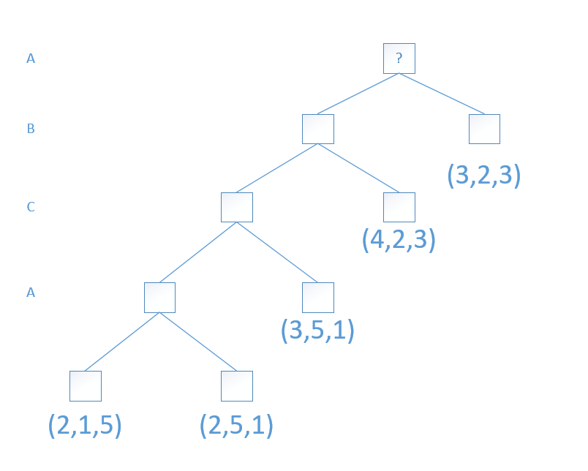
Multiple players
比如下图
2017 姚宇浩

Slide 13
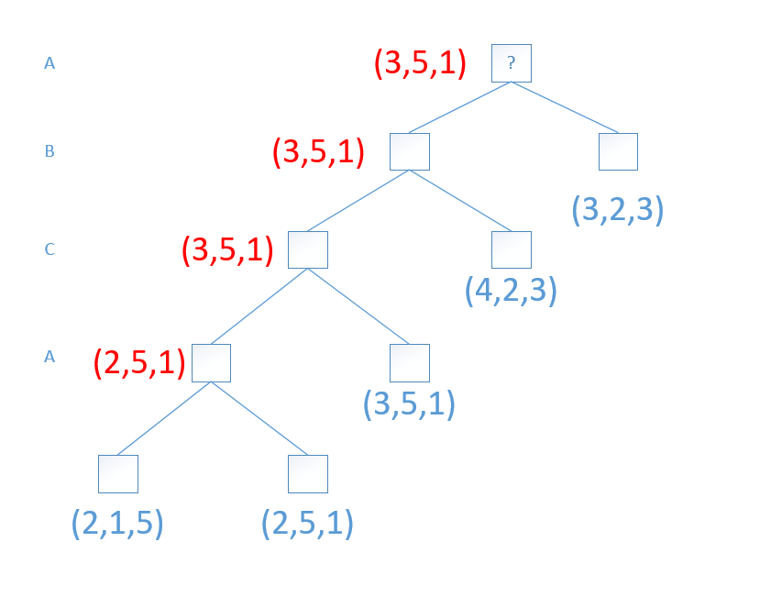
Multiple players
如果当有多个儿子的向量在该玩家对应的位置处取最大值，
随便选一个作为该点的向量可能会出现以下情况
2017 姚宇浩

Slide 14
Multiple players
但是这样得到的结果真的是对的吗？
绿色框圈中的这个点出发B真的能保证得到5吗？
注意，每个人只追求自己的值最大，不关心其他人的值。
2017 姚宇浩

Slide 15
Multiple players
B只有走左儿子才有可能得到5，但是如果是左儿子这点，
在C看来为了保证得到1其实往哪边走都可以，如过C又走
了左儿子，到了A走，A也选左儿子走，最后导致B只能得
到1。
2017 姚宇浩

Slide 16
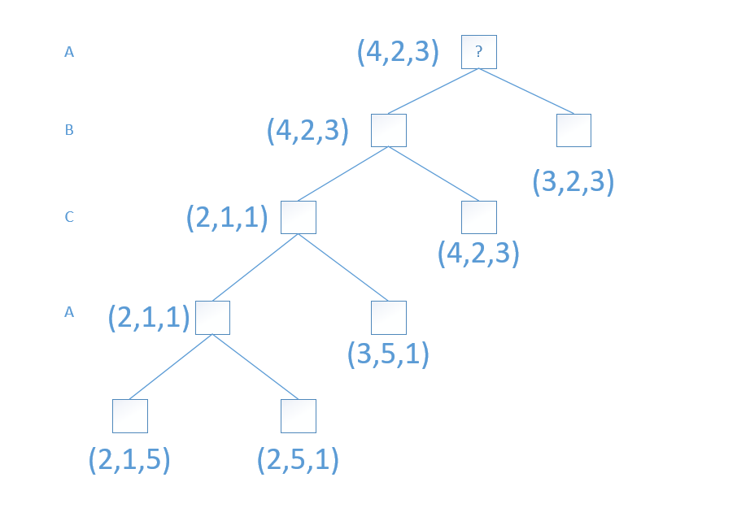
Multiple players
正确的做法应该是每次如果遇到有好几个儿子在最
大化分量上都取到最大值，那么对其他的某个分量应该将
这些向量在该分量上取最小值后得到该分量值。如图：
2017 姚宇浩

Slide 17
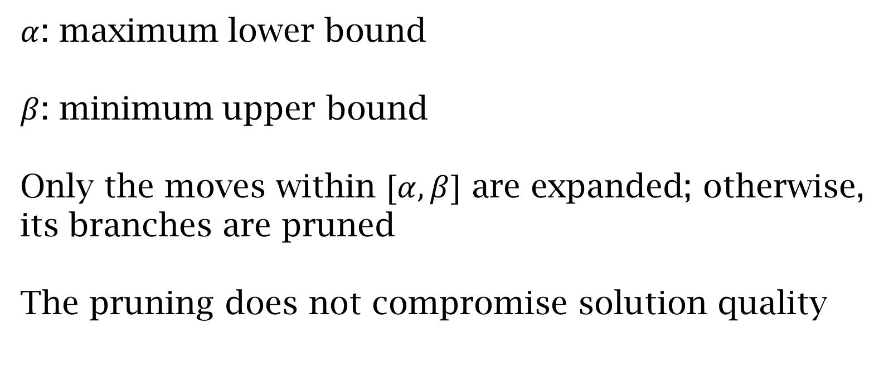
Alpha-Beta pruning
$α$: maximum lower bound
$β$: minimum upper bound
Only the moves within $[α,β]$ are expanded; otherwise,
its branches are pruned
The pruning does not compromise solution quality

Slide 18
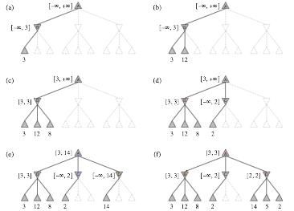




Alpha-Beta pruning
not all branches are needed
在当前状态下，该节点的utility在此范围
减枝
$[3,+∞]$
$[3,+∞]$
$[3,+∞]$
$[3,14]$

Slide 19
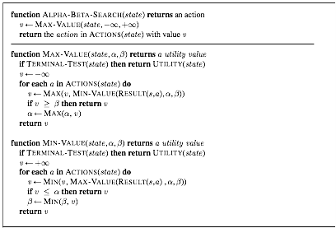
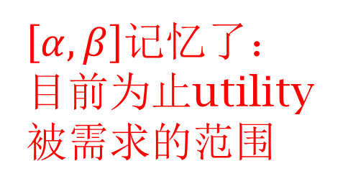
Alpha-Beta pruning
$\left[α,β\right]$记忆了：目前为止utility被需求的范围
返回的utility至少为v
返回的utility至多为v

Slide 20








Max_Value
α = $max(v,\text{α})$
-∞
α
β
Init
$$v_{2}$$
$$v_{3}$$
$$v_{1}$$
$$v_{1}$$
$$v_{3}$$
$$v_{2}$$
+∞
Init
α
β
β = $min(v,\text{β})$
Min_Value

Slide 21
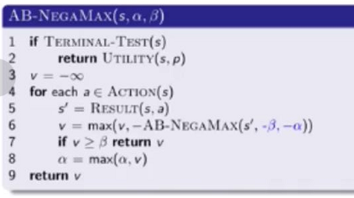
AB-NegaMax
视频：5-3

Slide 22
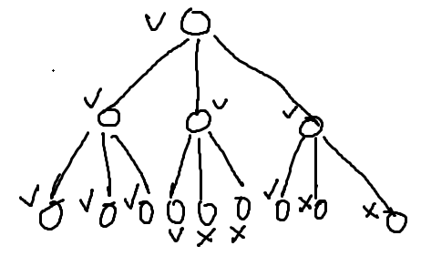
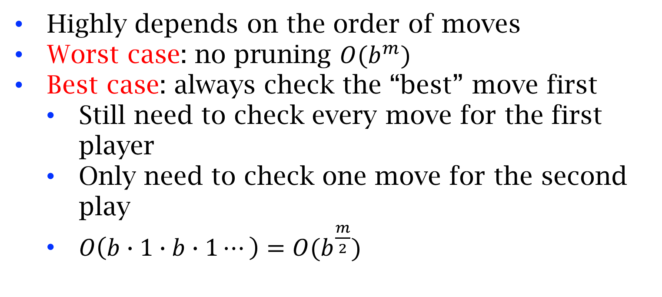
Properties of alpha-beta
Highly depends on the order of moves
Worst case: no pruning $O(b^{m})$
Best case: always check the “best” move first
Still need to check every move for the first player
Only need to check one move for the second play
$O\left(b∙1∙b∙1⋯\right)=O(b^{\frac{m}{2}})$

Slide 23
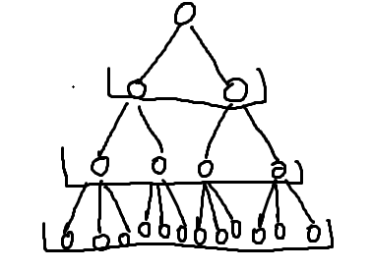
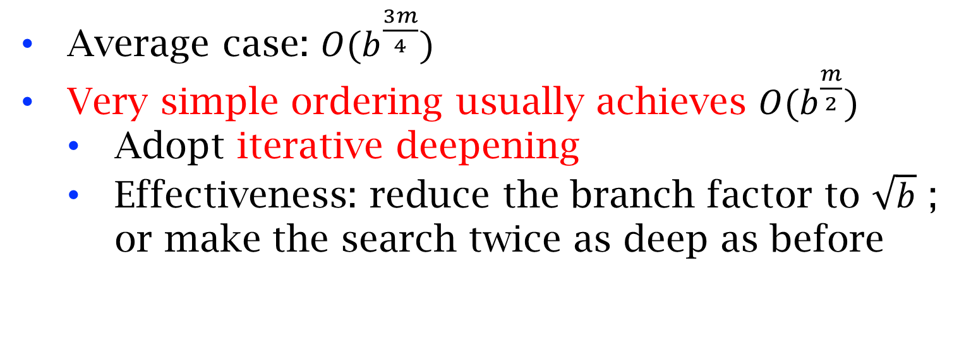
Properties of alpha-beta
Average case: $O(b^{\frac{3m}{4}})$
Very simple ordering usually achieves $O(b^{\frac{m}{2}})$
Adopt iterative deepening
Effectiveness: reduce the branch factor to $\sqrt{b}$ ; or make the search twice as deep as before
对每层节点重新排序

Slide 24
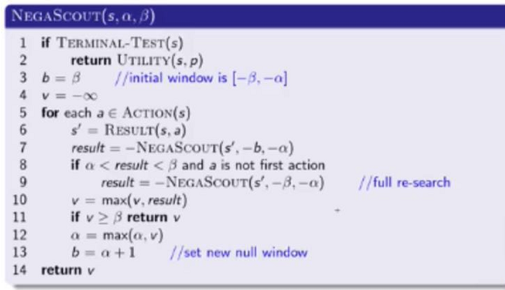
NegaScout
Contributed by Judea Pearl
视频：5-4
Homework: prove the correctness of this algorithm.
为什么在第一支的时候，不使用scout？

Slide 25
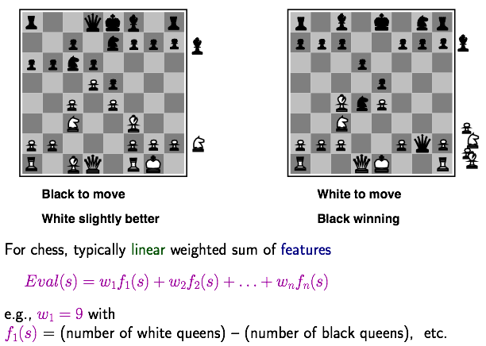
Recourse limit: evaluation functions

Slide 26
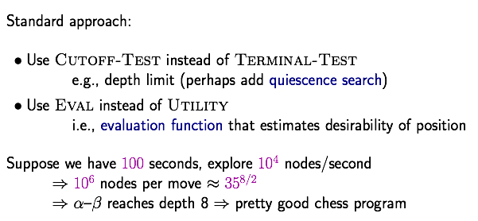
Resource limits
Horizon effect

Slide 27
Other techniques
Table lookup: end of the game
Zobrist hashing: to store each state
Key for each piece at each position
A state is the XOR of the keys for each piece in the current state
Fast retrieval in table lookup
x XOR a XOR a = x

Slide 28
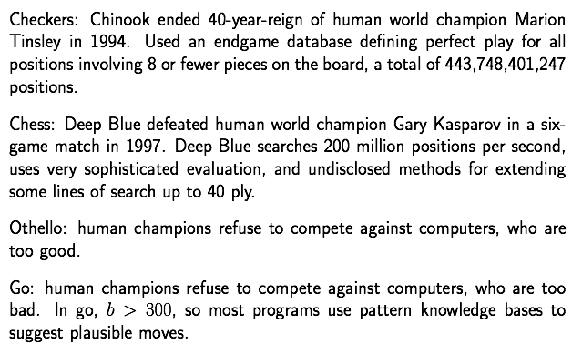
Deterministic games in practice
西洋跳棋
国际象棋
黑白棋
围棋

Slide 29
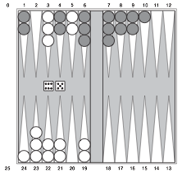
Stochastic games
Backgammon (西洋双陆棋):

Slide 30
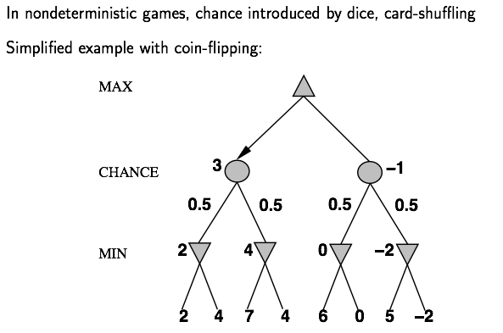

Expect-minimax

Slide 31
Performance of expect-minmax
Pruning only at the chance nodes
Branch factor: from b to bn (n is the number of distinct dice rolls)
Impractical
Monte Carlo simulation
Using random dice rolls to check only a certain number (decided by the resource limit) of paths
Average the utility of all these paths

Slide 32
Partially observable games
Different from stochastic games, unobservable parts are usually controlled by opponents, not probability.
Examples: folded cards in poker, fogs in star craft
Different strategies may be applied and may all consider optimum against different opponent
If equilibrium exists, it’s usually considered as optimum strategy

Slide 33
Nash Equilibrium
John Nash: “A Beautiful Mind (2001)”, died in a car crash at 2015
Definition: a set of strategies is a Nash equilibrium if no play can do better by unilaterally changing her strategy
Prisoner’s dilemma
 | B stays silent | B confesses
A stays silent | 1 yr for each | A: 5yr; B:free
A confesses | A: free; B:5yr | 3 yr for each

Slide 34
Summary
MiniMax search for zero-sum two-play games with perfect information
Alpha-beta pruning enable to search deeper
Due to resource limit, heuristics are used to evaluate the “goodness” for a state
For stochastic games, we need to introduce chance nodes and search expected max/min values
For stochastic games, pruning is much less efficient. Thus, Monte Carlo simulation are often used.
With partial observation, “optimality” is usually not well defined. If equilibrium exists, strategies in equilibrium are often considered optimum.

